Slide 1
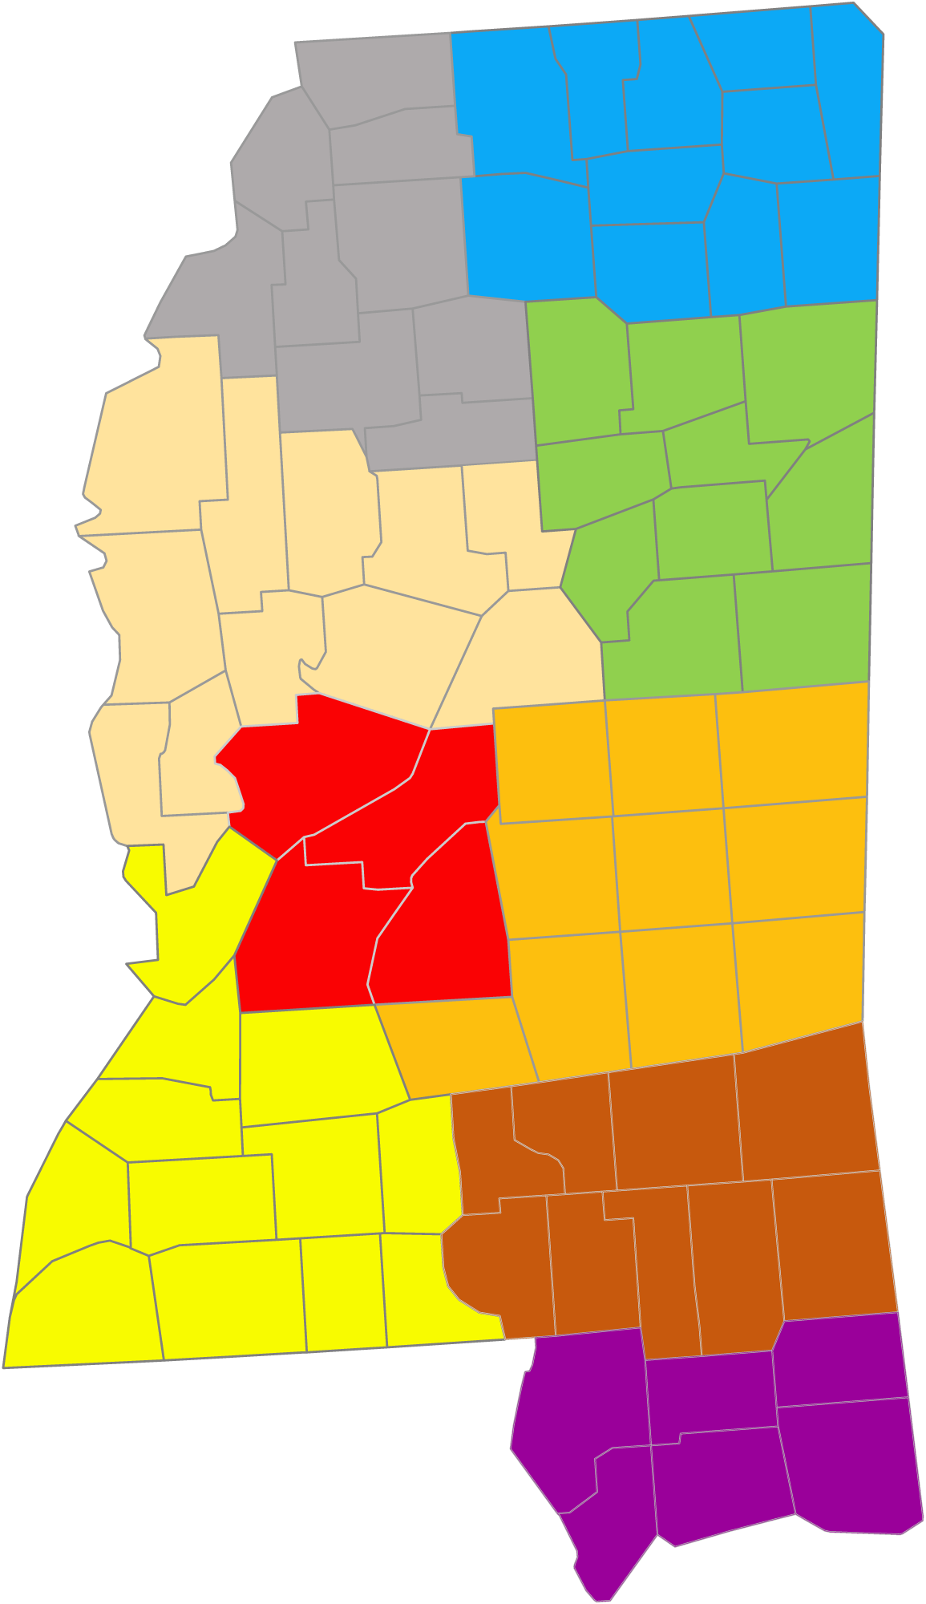
MED OPS
Notes:
Welcome to the Mississippi State Resource page! This presentation will guide you through the website, your go-to resource for learning about Pulsara, signing up, and implementing Pulsara MED OPS.

Slide 2
EXTENSIONS
INFRASTRUCTURE
Hospital Functionality by Package
BUNDLE OPTIONS
All hospital bundles include either Pulsara ONE or Pulsara MED OPS Infrastructure Package. Hospitals can upgrade to Pulsara UNITED which includes all hospital functionality OR they can add Pulsara TRANSFER OPS and/or Pulsara SELECT to meet their needs.
Pulsara ONE
Pulsara MED OPS
Pulsara TRANSFER OPS
Pulsara SELECT
Pulsara UNITED
v
OR
v
AND/OR
OR
Multimedia Prehospital Report (ECG, Video, PSR…)
ALL
ALL
ALL
ALL
ALL
ALL
ALL
ALL
Send Consult/Transfer Request
ALL
ALL
ALL
ALL
ALL
ALL
ALL
ALL
State | Regional: Incidents, Events, Evac, ESF8 & other Initiatives
ALL
ALL
ALL
ALL
Receive Consult/Transfer Request
ALL
ALL
ALL
1-2
ALL
ALL
ALL
Add Physician Consultants for Consult & Transfer Request
ALL
ALL
1-2
1-2
ALL
ALL
Add Physician Consultants All Methods of Arrival (EMS, ED, Inpatient, Transfer)
1-2
1-2
ALL
ALL
Add Downstream Teams (STEMI, Stroke, Trauma…) All Methods of Arrival (EMS, ED, Inpatient Transfer)
1-2
1-2
ALL
ALL
Always Free to Everyone
Free to Hospitals in MED OPS Regions
Adds
Consultants
Adds 1-2
Patient Types
Includes ALL Extensions
Notes:
Many regions across the state have successfully implemented Pulsara as part of a STEMI and Stroke initiative. If you haven’t expanded use beyond these patient types, we encourage you to check out our enhanced workflows that simplify patient movement for all encounters.
Pulsara ONE is our foundational infrastructure package designed to modernize EMS-to-ED prehospital notifications. It replaces traditional notification methods for all patient types while enabling ECG attachments and live video.
This essential functionality is offered nationwide at no cost to participating First Responder Organizations, EMS Agencies, and Hospitals—no hidden fees, no catch. It’s simply our investment in building a multi-sided, HIPAA-compliant network, which serves as the foundation for our shared success.
The entire state of Mississippi has been upgraded to Pulsara MED OPS. In addition to the core Pulsara ONE features, this upgrade unlocks Incident Management capabilities for handling Mass Casualty Incidents, Mass Evacuations, and Mass Gatherings, as well as broader regional and statewide initiatives like load balancing, behavioral health coordination, and complex multi-agency operations.
Additionally, EMS has upgraded functionality, and hospitals now have access to enhanced inter-facility functionality, enabling seamless consults and transfer requests between facilities. While Pulsara offers additional optional paid packages, this resource focuses on our infrastructure packages. If you’re interested in learning more, feel free to request a demo or ask a Pulsara Team Member any questions.
It’s important to note that our team members do not work on commission or have sales quotas—our priority is building a strong, connected network that supports your needs.

Slide 3
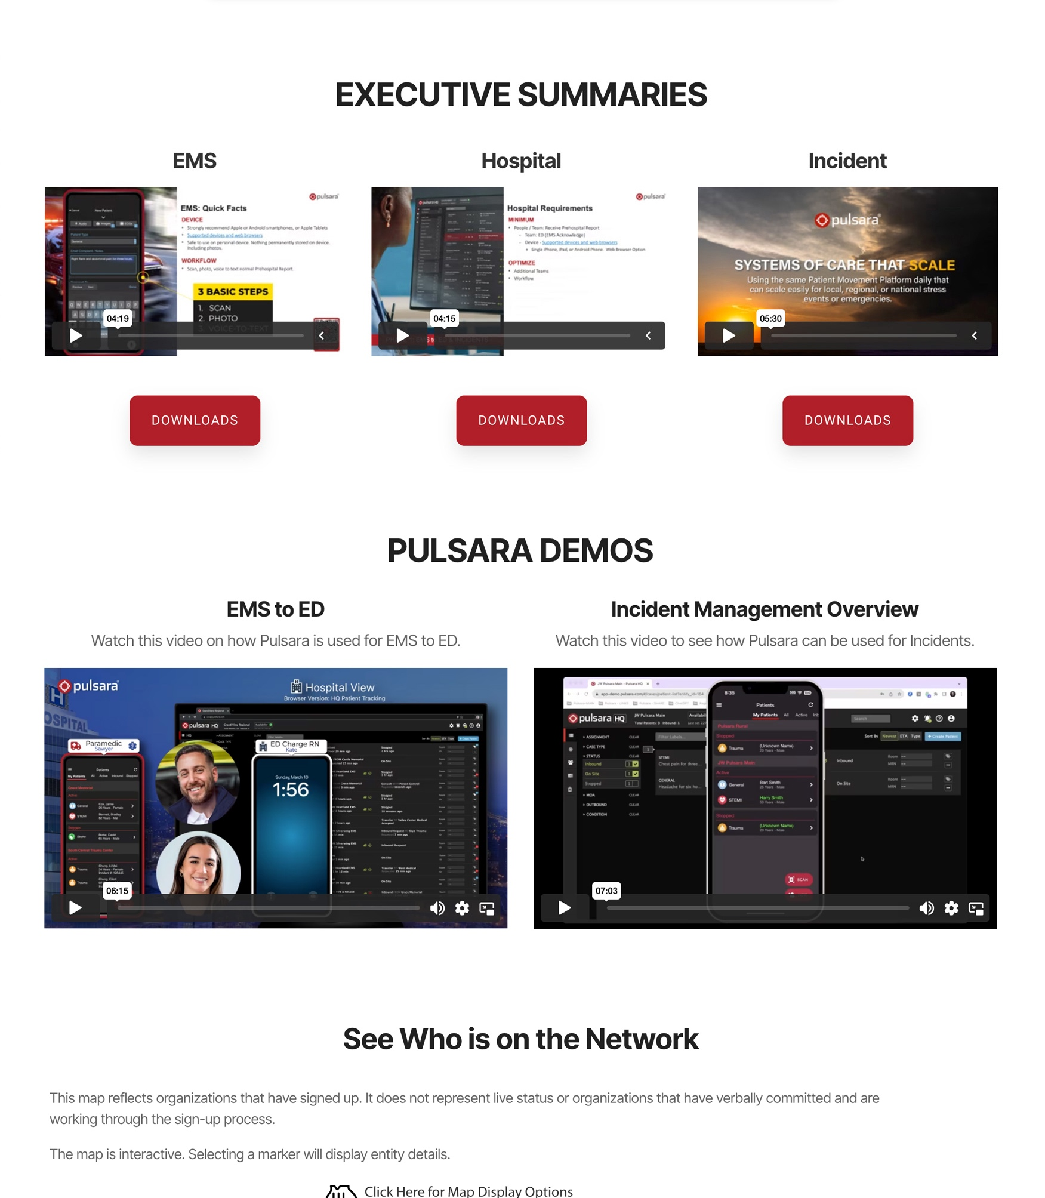
Discovery | Socialization
EMS
Watch or Download and Review EMS Executive Summary (5 min)
Watch EMS to ED Demo (6 min)
Hospitals
Watch or Download and Review Hospital Executive Summary (4 min)
Watch EMS to ED Demo (6 min)
Incidents
EMS & Hospitals
Watch or Download and Review Incident Executive Summary (5 min)
Watch Incident Overview Demo (7 min)
Notes:
We offer separate tracks for EMS and Hospitals, allowing you to quickly grasp the problem, solution, value, and next steps for implementing Pulsara in just 10 minutes—all while seeing the platform in action. If Incident functionality is relevant to your role, an additional 13-minute session provides deeper insight.
While MED OPS regions offer a wide range of capabilities, new organizations typically start by focusing on core functionality, including EMS-to-ED communication and Incident Management

Slide 4
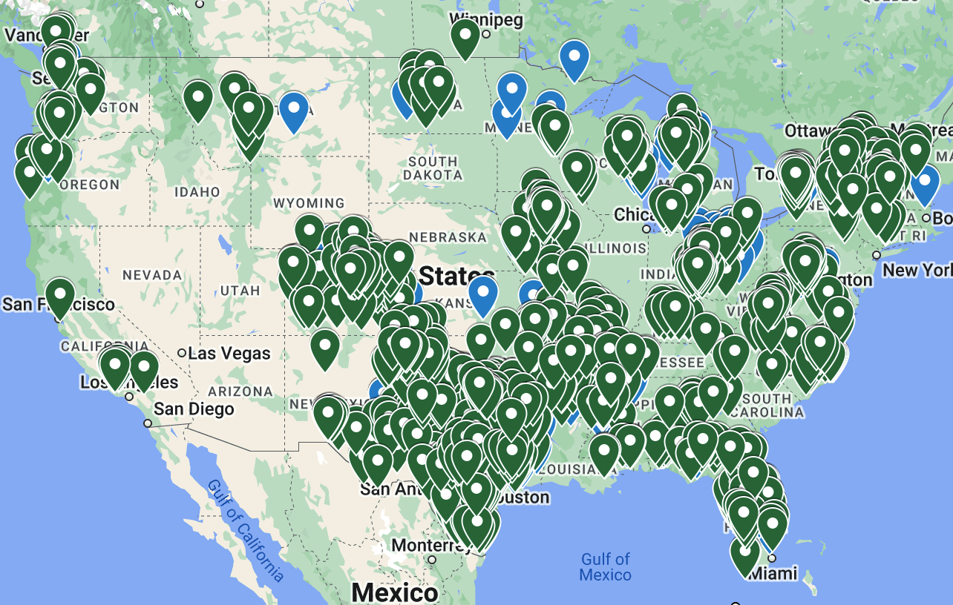
Who is on the Network?
Interactive Map
See Who has Signed Up
Does not represent Implementation or Live Status
It does not represent organizations that have verbally committed and are working through the sign-up process
Regional Projects
Located at the bottom of the page and accessible via top navigation
Displays implementation status of active projects
Showcases regional projects and workflows
Highlights other initiatives (Pulsara MED OPS regions)
It CAN be Done!
Proven success – thousands of organizations already connected
Functionality seamlessly extends across state lines
Notes:
Finding out who is on the network is simple using the interactive map.
If your region is actively implementing Pulsara, visit the Regional Project section to track each organization’s progress. This section also provides details on region-specific workflows and projects.
While many of you think about Pulsara as a STEMI and Stroke solution, we’re just getting started with Pulsara MED OPS in Mississippi. The bottom image showcases adoption across surrounding states, demonstrating what’s possible.

Slide 5
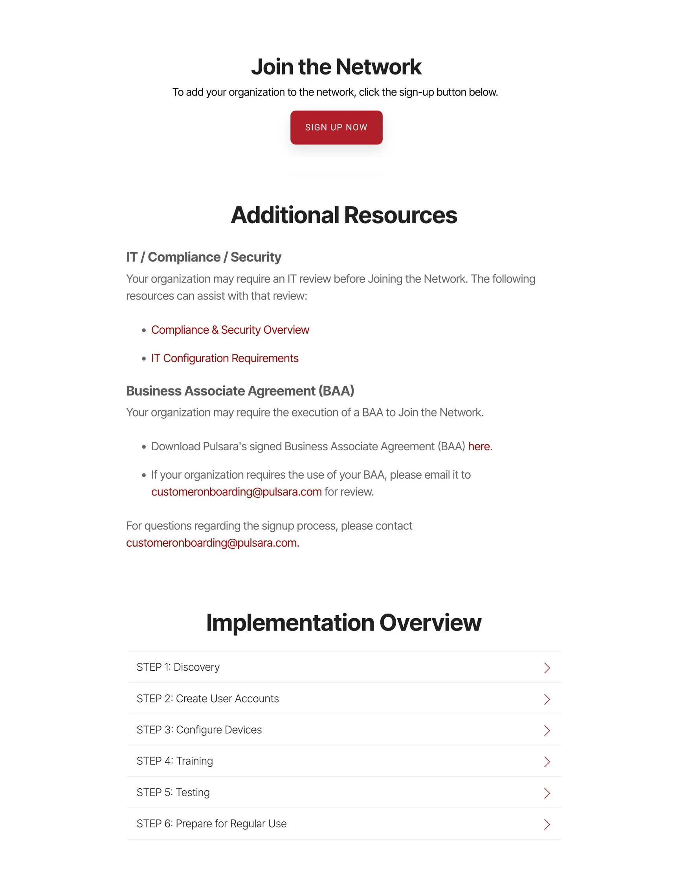
Sign Up | Procurement
Who to Engage
EMS: Leadership
Hospital: ED and Executive Sponsor
Use this Resource Page to assist with socialization
Sign Up Now
Sign up to join the queue with no commitment to a timeline or completing onboarding.
Pulsara will collaborate with you and your region to coordinate training and implementation timelines
Additional Resources
Assets to help you navigate your internal IT / Compliance / Security process
Business Associate Agreement (BAA)
Implementation Overview
Notes:
Engaging Emergency Department leadership is key to a successful rollout. We also recommend securing an executive sponsor, as they will want to understand the regional impact and scope of the project. They can also help navigate your organization’s IT adoption process.
The most important step? Sign up as soon as possible. This ensures you’re in the queue, allowing us to coordinate your region effectively for a smooth implementation and avoid any false starts.
You’ll also find resources to guide you through internal IT and Legal Procurement processes, along with a clear roadmap of what to expect during implementation.

Slide 6
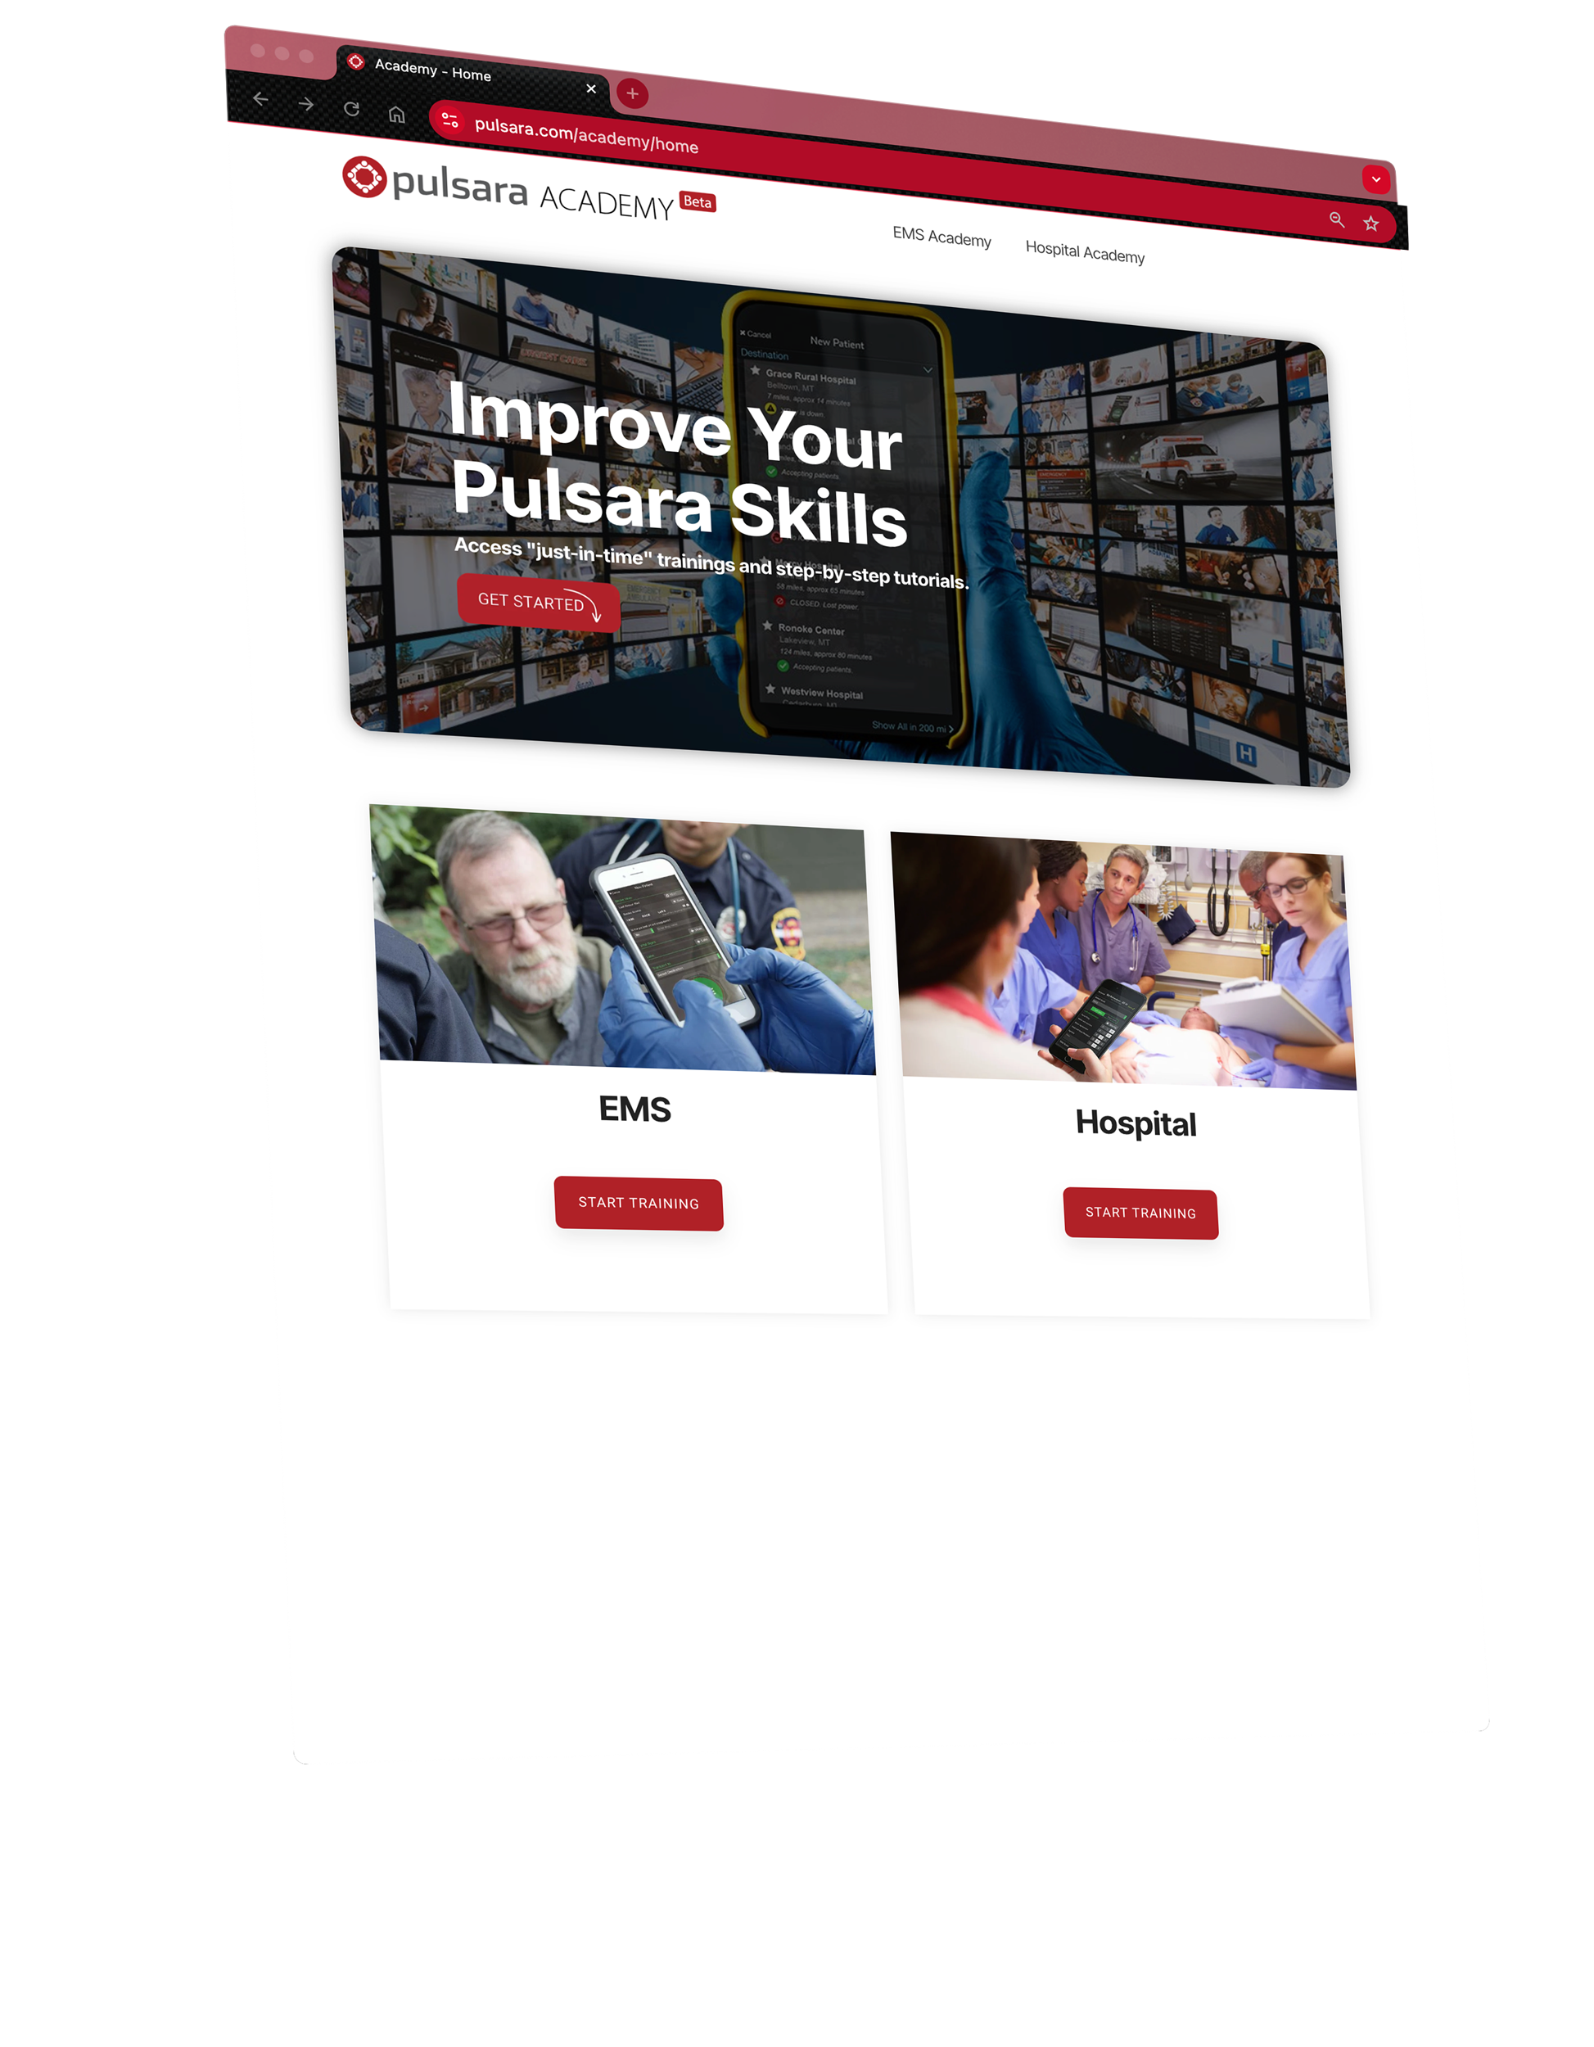
Pulsara Academy / Training
Content
Socialization
Pulsara Basics (conceptual)
How To
Demos
Just-In-Time Training Assets
Consume as Needed
Videos
Printable / PDF
PowerPoint
Options
Download & Customize
Link to your LMS
Onboarding & Ongoing Training
Notes:
To support both initial and ongoing training, we provide a variety of resources, including short videos, slide presentations, and printable Just-In-Time training materials, ensuring easy access to the information you need.

